Slide 1
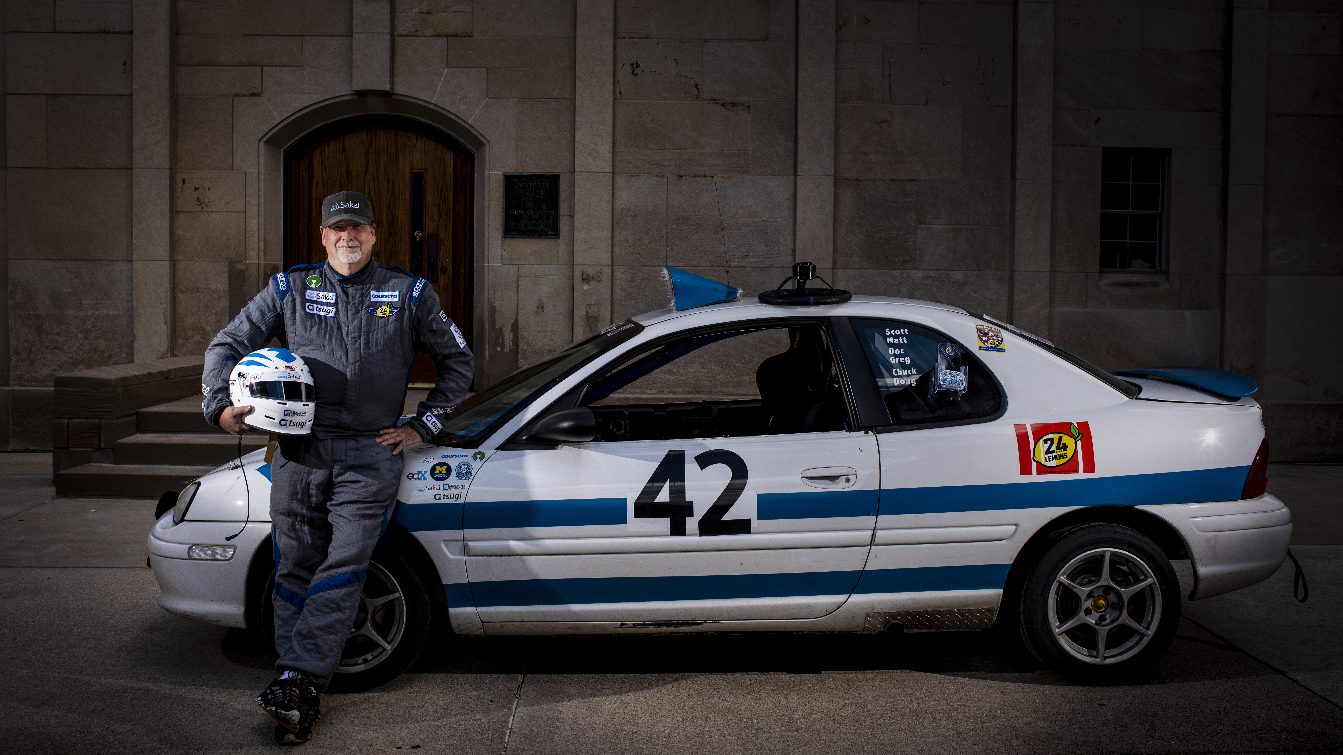
Python for Everybody
Charles R. Severance
www.py4e.com
Photo: Jeffrey Smith

